Slide 1
What is the NGDS
The National Geothermal Data System:
Implementation of the U.S. Geoscience Information Network
Stephen M Richard
Kim Patten
Virginia Geological Survey
August 7, 2013

Slide 2
Outline
Overview: What and Why
How it is put together
How does it work

Slide 3
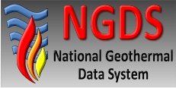
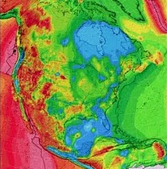
NGDS strategy to reduce geothermal development risks
System Design, Development and Testing:
Consortium led by Boise State University: leverage the Geosciences Information Network (NSF, U.S. Geological Survey, and American Association of State Geologist) for system design
Data Development, Collection & Maintenance:
Populate NGDS data sets in partnership with State Geological Surveys and other geothermal data providers including Southern Methodist University and GTP technology partners.
National Resource Assessment
Inter-Agency Agreement with U.S. Geological Survey
Notes:
Data System Design & Testing BSU and Subcontractors: University of Utah Co-PI – Joseph Moore; Arizona Geologic Survey; UNR (Great Basin Center); OIT (Geo Heat Center); Stanford University
Developing data model and data quality standards to link to high quality data sets of geothermally relevant information from thousands of wells across the United States, digitize old paper and core data, and leverage otherwise proprietary oil and gas well data. The availability of this data to the public and Industry will facilitate better assessments of geothermal resources and will reduce high upfront costs and risk associated with geothermal exploration.

Slide 4
AASG State Geothermal Data Project
Compile and capture legacy data from State Geological Surveys
3 years, each includes statement of work, review, data capture, review, and registration
AZGS acts as coordinator for 45 Subcontracts, involving all states
Additional projects to capture new data

Slide 5
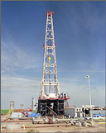
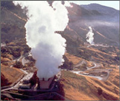
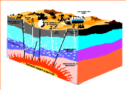
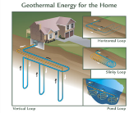
Purpose
Make data resources of State and Federal geological surveys accessible online in a distributed network by
using common standards and protocols
working with data providers to implement these services.

Slide 6
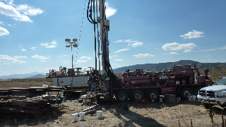
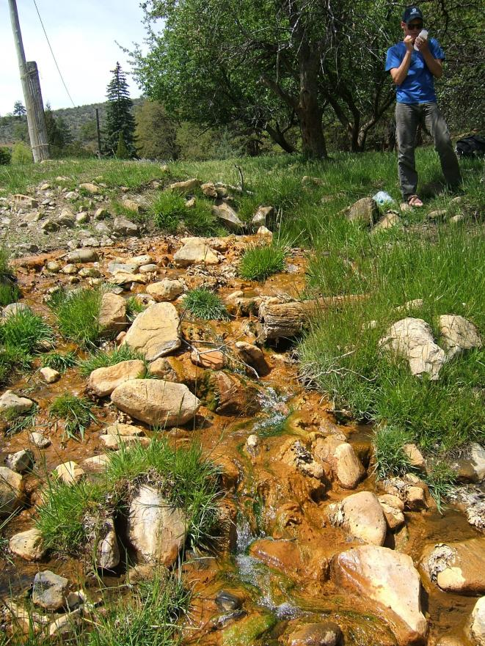
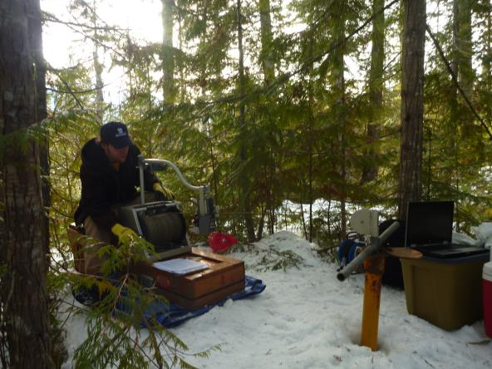
New Data Collection
New temperature gradient wells UT, ID, WA, WI, OR & NV
Thermal Spring Sampling in WA & AZ
Temperature logging in WA

Slide 7

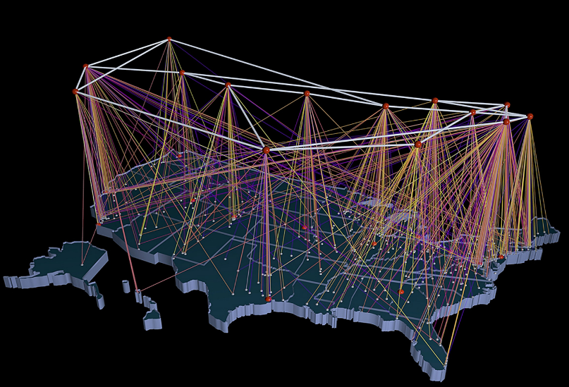




University of Utah Energy & Geosciences Institute
U.S. DOE Geothermal Data
Repository hosted at NREL
Oregon Institute of Technology,
Geo Heat Center
Stanford Reservoir Engineering
U of Nevada Reno
U.S. DOE Geothermal Data
Repository hosted at NREL
Southern Methodist University Heat Flow Laboratory
U.S.
Geological
Survey
50 State Geological Surveys
Managed by AZGS

Slide 8
Overview
NGDS is a data system, not a database
Discover and access geothermal data from many different sources
System is unified by:
Catalog and standardized metadata
Data access protocols and interchange formats (it’s the Web for data)

Slide 9
What defines the network
Specifications
People and software using them
Information Exchanges
Service Protocol – how message are sent to ask for and get data
Content models – what information is available
Interchange formats – how the information is encoded (e.g. HTML, xml, json, txt, xls)

Slide 10
Why
Is interoperability worth the pain

Slide 11
Make things easier
Make life easier for the customer
They don’t have to do figure out new data structures
Create bigger market for applications
App works with different data providers
Facilitate machine processing
Make metadata easier
Don’t have to document data structure-it’s already done.
Simplify data maintenance

Slide 12
Outline
Overview
How is it put together
Data
Catalog
How does it work
Content Models
Interchange formats
Catalog

Slide 13
A distributed data system
Web services: the connections
Users
Data space
Data: the World Wide Web as the data store
Catalogs: listings of available resources

Slide 14
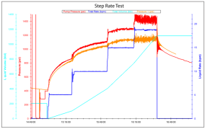
Data Types
Three sorts of information:
Data – information about the Earth and geothermal energy systems
Metadata – Information about resources (for discovery, evaluation, access)
Annotation – notes added to by the community (ratings, comments, reviews, usage…)

Slide 15
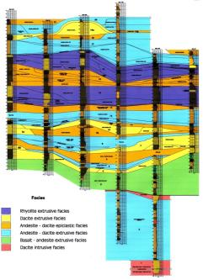
Data Priorities: Domain steering committee
Solicit input from experts
Content models
User stories – functionality and data output
Sustainability – future user input
Prioritize based on geothermal community input
Review content models
Provide recommendations to Project Management

Slide 16
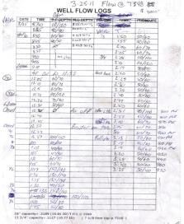
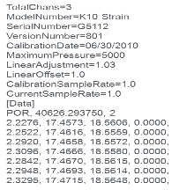
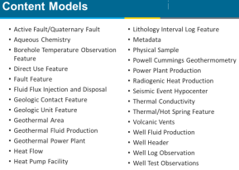
Data Interoperability Tiers
Tier 1: unstructured content in files
Text, images, graphics files
MS Word, Adobe Acrobat, Illustrator, TIFF….
Tier 2: Structured data, custom formats
May be accessed in files or via services
Excel, Microsoft Access, dbf, xml…
Tier 3: Information Exchange:
Structured data in standard schema and encoding
Deliver via web service, or in file.
Tier 1
Tier 2

Slide 17
Being part of the system
Any Tier: Resource is described by metadata in the system catalog
Tier 1– File accessible on the Web
Tier 2– Structured, user does data integration
need to document data format
Tier 3 – Structured, provider does data integration
mapped to community interchange scheme
provider has to validate format

Slide 18
The Catalog
Services: structured data discovery and access
Data space
Data: the World Wide Web as a file system
Catalog: registry of available resources

Slide 19
Metadata Content Model
Access constraints
Language
Quality
Lineage
Citation
Distribution contact
Metadata
Date
Contact
Specification
Identifier
Title
Extent
Geographic
Vertical
Temporal
Access instructions
Description
Keywords
Originator(s)
Date
Resource ID
Online document: http://lab.usgin.org/profiles/doc/metadata-content-recommendations

Slide 20
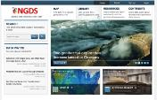




Metadata cloud
NGDS portal – access point for geothermal community
NGDS aggregator: collect metadata for all NGDS resources
NGDS portal
Metadata contributors
Other portals

Slide 21
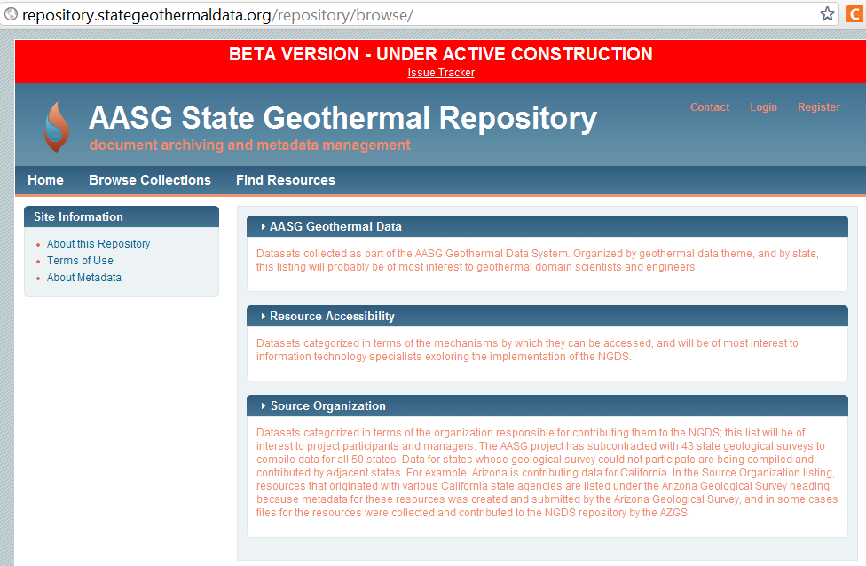
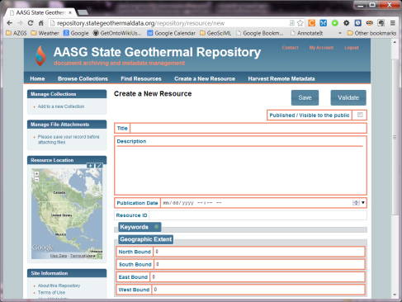
Metadata Repository Tool
Generate and manage metadata
Registry of resources
Upload capability
Django/NodeJS implementation

Slide 22
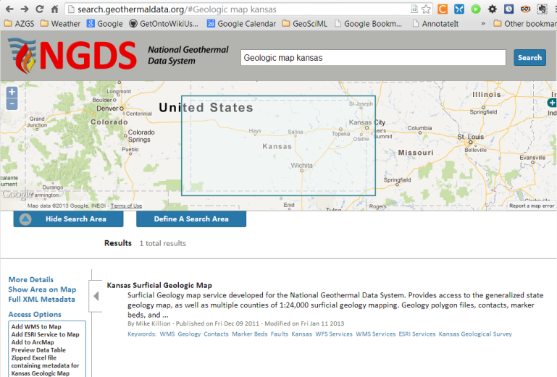

Search Client
Uses CSW interface

Slide 23
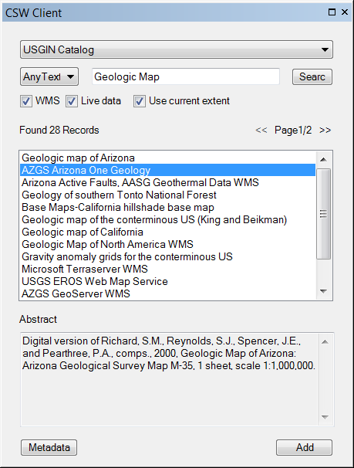
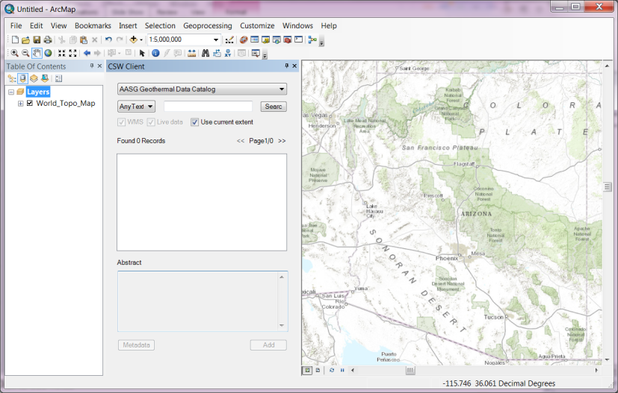
ArcGIS CSW Client

Slide 24
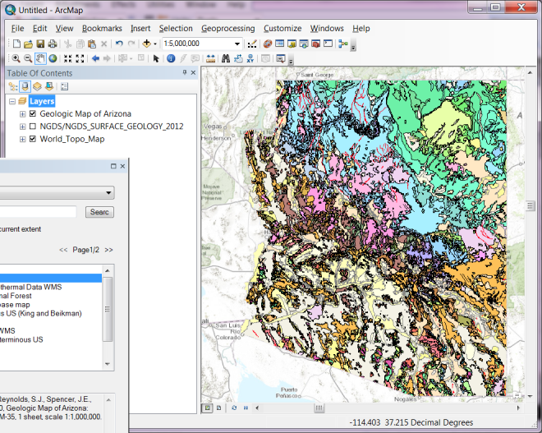
Display map in ArcMap

Slide 25
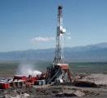
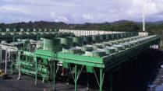
Tier 3: Information Exchanges
Conventions for how information will be sent between computers
Designed for consumption by computer software
Content Model:
Defines the information content
Data schema
May be implemented with various encoding formats
Encoding formats
HTML, XML, JSON, NetCDF, TIFF, JPG…
facilityType: “Air-cooled binary plant”

Slide 26
Content Models (Tier 3)
Active Fault/Quaternary Fault
Aqueous Chemistry
Borehole Temperature Observation Feature
Direct Use Feature
Fault Feature
Fluid Flux Injection and Disposal
Geologic Contact Feature
Geologic Unit Feature
Geothermal Area
Geothermal Fluid Production
Geothermal Power Plant
Heat Flow
Heat Pump Facility
Lithology Interval Log Feature
Metadata
Physical Sample
Powell Cummings Geothermometry
Power Plant Production
Radiogenic Heat Production
Seismic Event Hypocenter
Thermal Conductivity
Thermal/Hot Spring Feature
Volcanic Vents
Well Fluid Production
Well Header
Well Log Observation
Well Test Observations
Notes:
26

Slide 27
Outline
Overview
How is it put together
How does it work
Delivery platforms
Software tools

Slide 28
Delivery Platform
File download
simple Web link that results in a file download
no support for understanding content
little or no automation is possible
Web application
User-driven computer program, run in client browser
form-based querying, browser-based visualization
may offer file downloading (clip and ship, query results…)
Web Service
computer program executes requests sent via the World Wide Web
Interface for machine to machine interaction
Execute filtering or processing of data on server side
CKAN node in a box to simplify
Notes:
Add NIAB information

Slide 29
Tiers and delivery platforms
 | Tier 1 | Tier 2 | Tier 3
File download | X | X | X
Web application |  | X | X
Web service |  | X | X

Slide 30
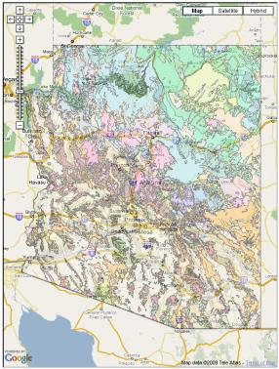
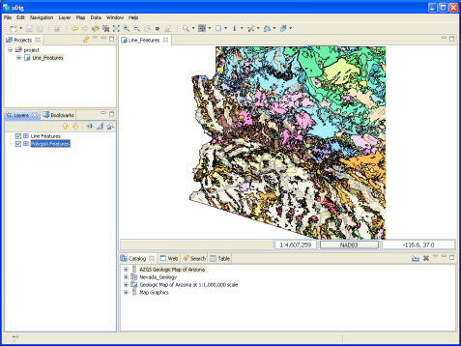
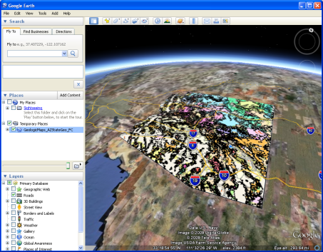
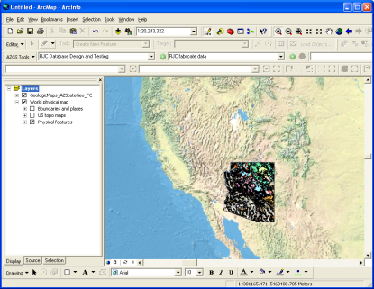
Data Delivery Platform: web services
OGC Services
-- Useful in Existing Applications
WMS for providing a symbolized portrayal of vector data
WFS for full access to attributes and to download vector data
WCS for access to continuous raster data

Slide 31
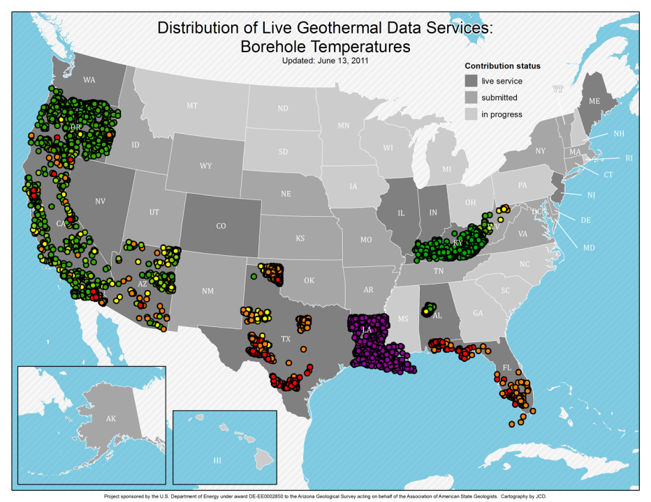
Map Services require consistent map legends for integration
OOOPS!

Slide 32
Protocol – Web Feature Service (WFS)
Open Geospatial Consortium Web Feature Service
Standard, structured encoding of content
Each feature defines content model (xml schema)
Feature service –
designed for data access based on features (representation of geolocated entity with attributes)

Slide 33
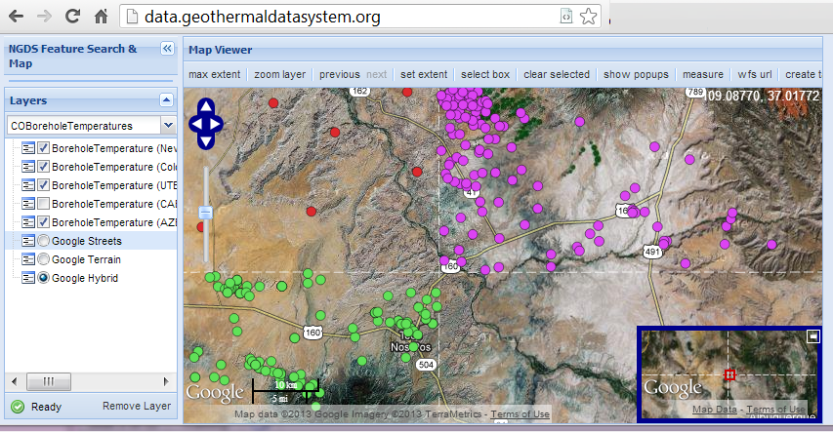
Example: NGDS Borehole temperatures

Slide 34
USGIN URI redirect
URIs dereference to one or more online representation of each resource. Examples:
http://resources.usgin.org/uri-gin/isgs/well/API:120010005200/
http://resources.usgin.org/uri-gin/isgs/welllog_tif/120010010800_ies/
Links data resources: linked open data…
Notes:
Simplify

Slide 35
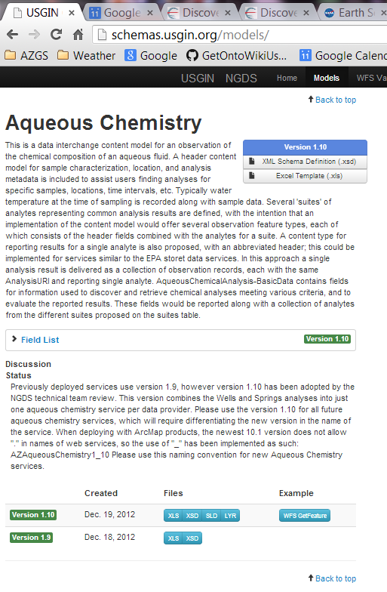
Tools Schema Repository
Registry/repository
Field descriptions from schema annotation
Links to Excel workbook view
Links to XSD
Versions
Link to example instances

Slide 36
Deployment
‘Node in A Box’
Build on CKAN data hub software project
Installable stack to provide all components necessary to provide NGDS services
Resource registration and upload
Catalog search, metadata integration
Data services
Linux or Windows Server;
Aggregator or Data provider configuration

Slide 37
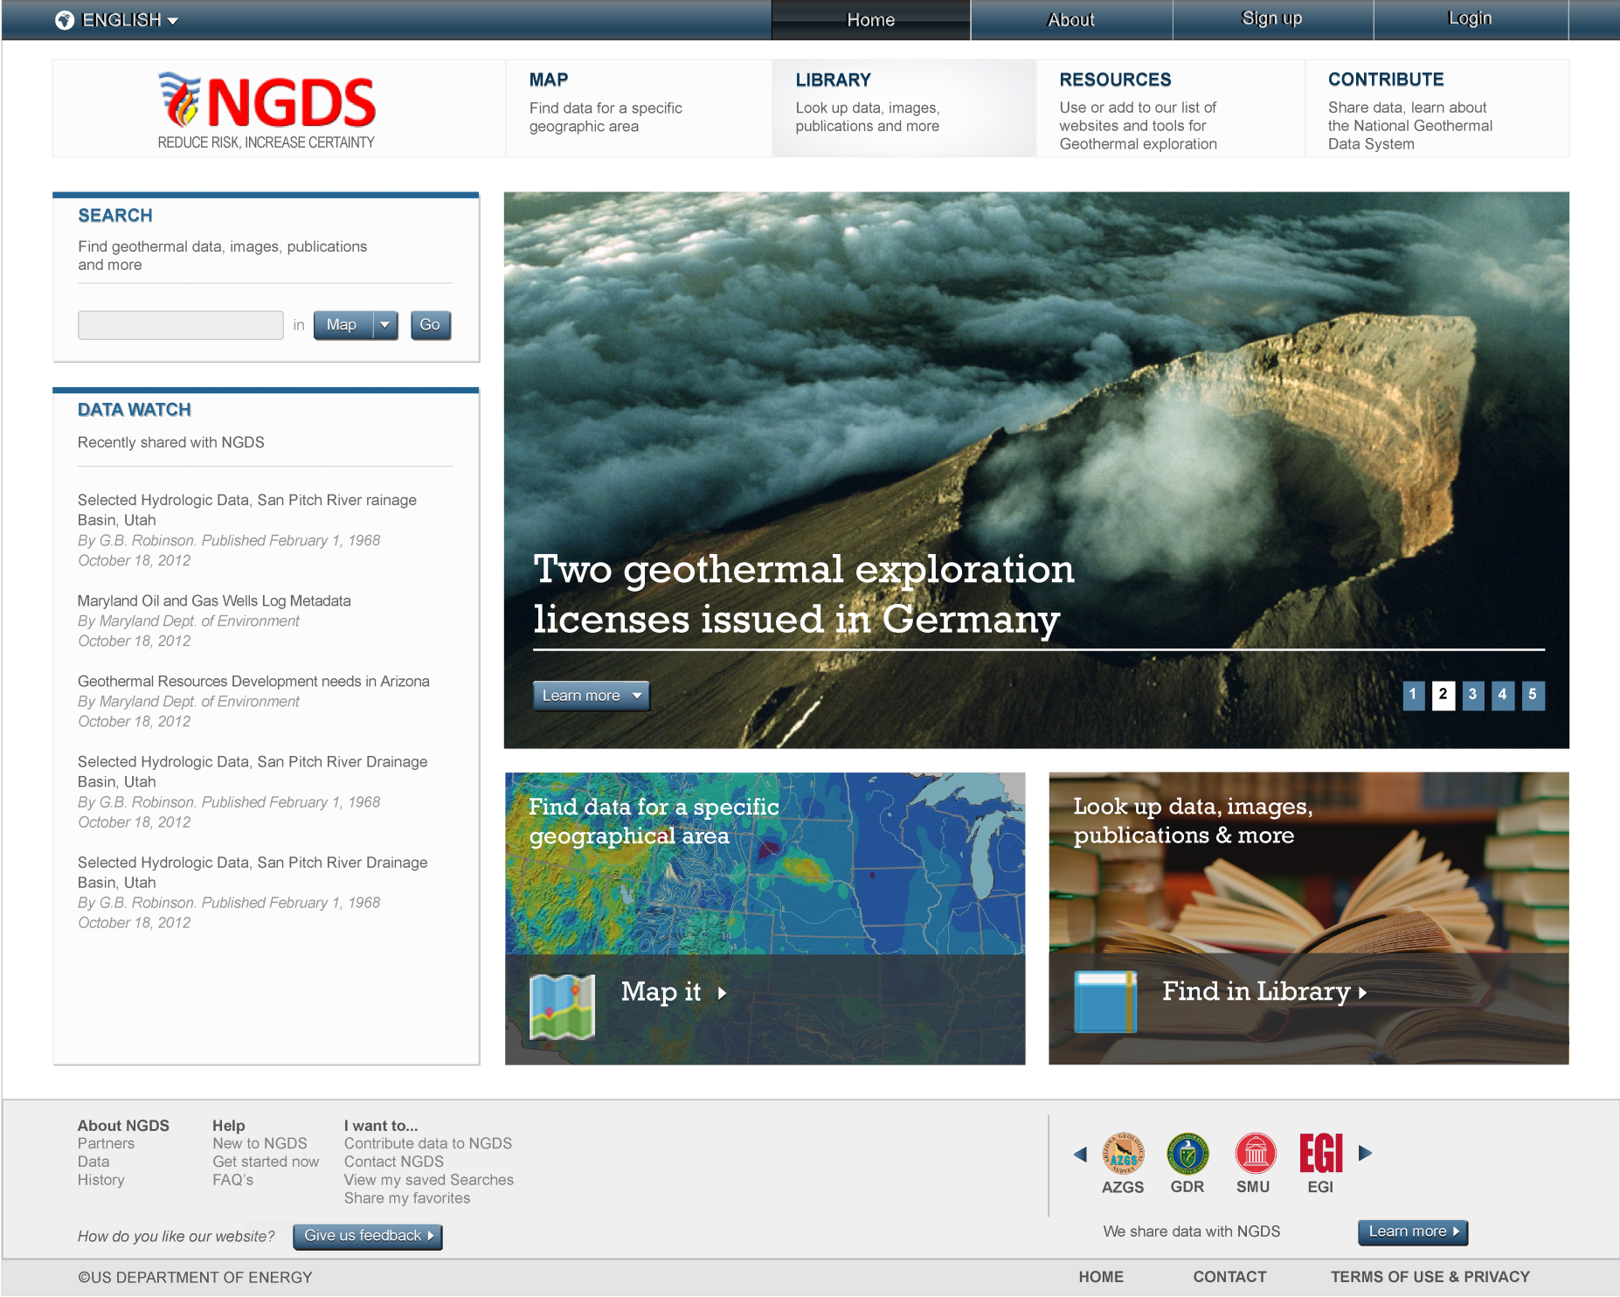
Notes:
** Labeled as Final Design in NGDS UI Design 7/22/2013 presentation.

Slide 38
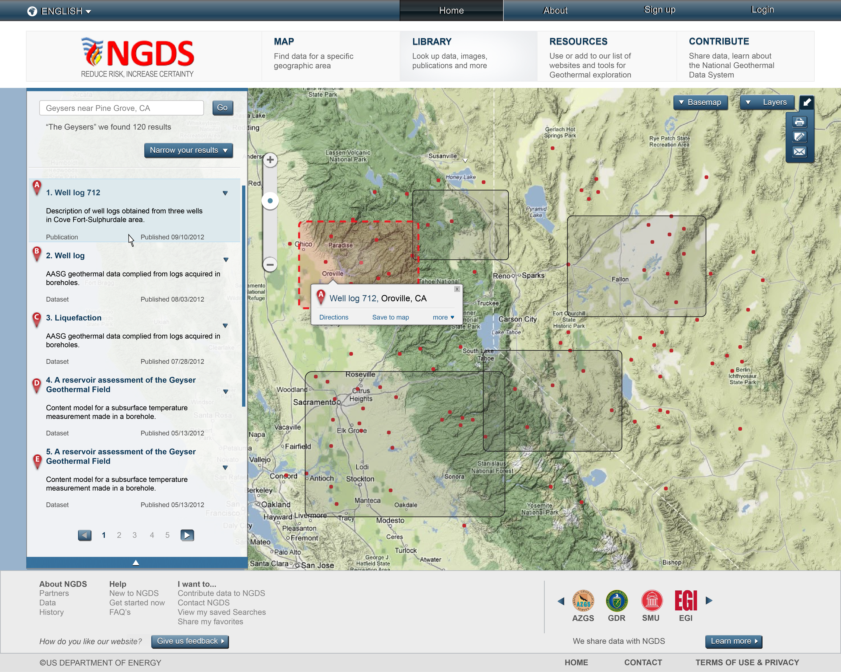
Notes:
Search results window viewable

Slide 39
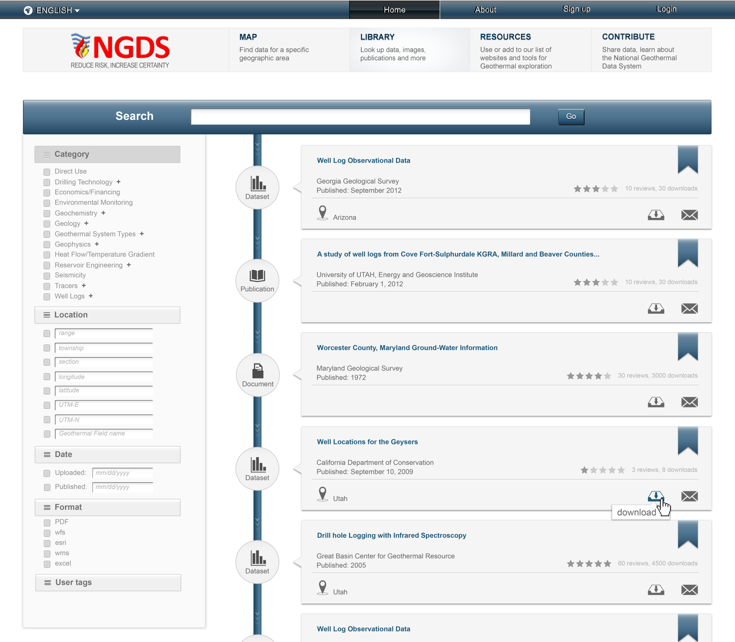
Notes:
Library view

Slide 40
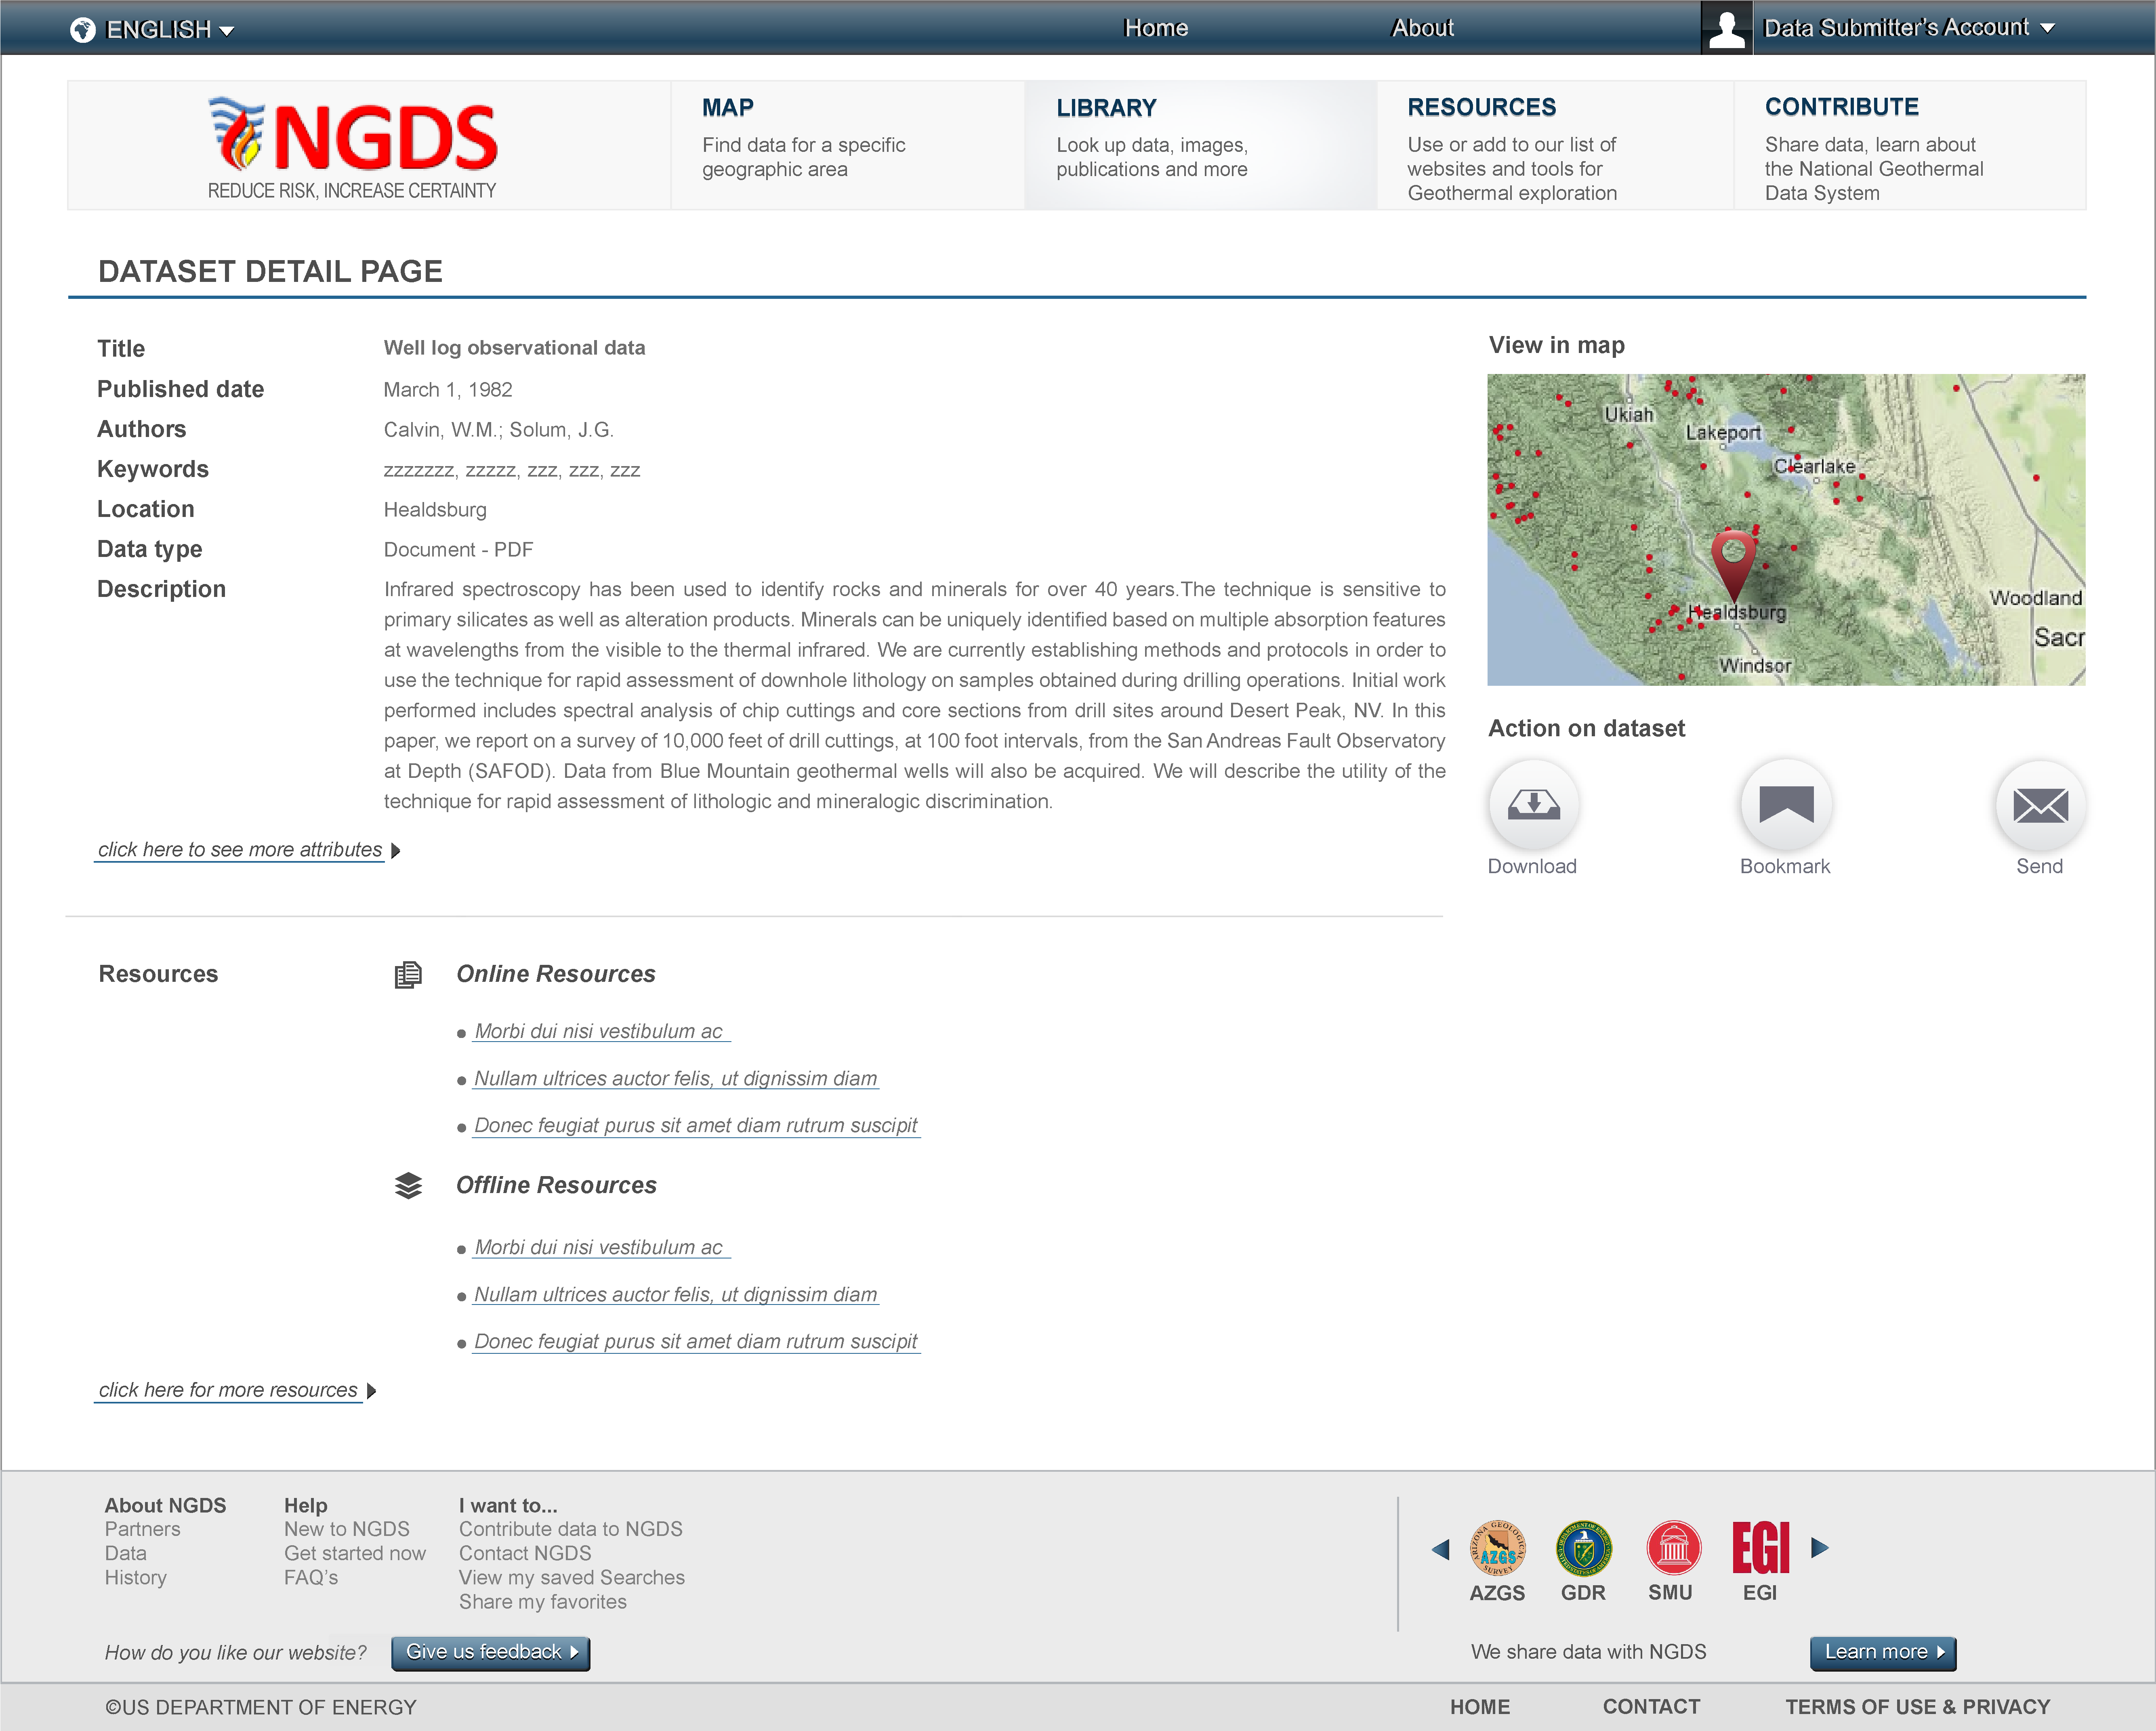
Notes:
Library View

Slide 41
Conclusions
The World Wide Web is the file system and data repository
Resources include:
Structured and unstructured data in files (most of the content)
Standardized structured data accessible through web services (metadata and some data)
Information exchange specifications:
Conventions for content model and encoding enable applications to work with multiple data sources

Slide 42
Discussion
USGIN:
Community for developing Geoscience Information Exchanges
Metadata exchange is most important
Majority of content is unstructured documents
Challenge: what is value proposition for ‘long tail’ information exchanges

Slide 43
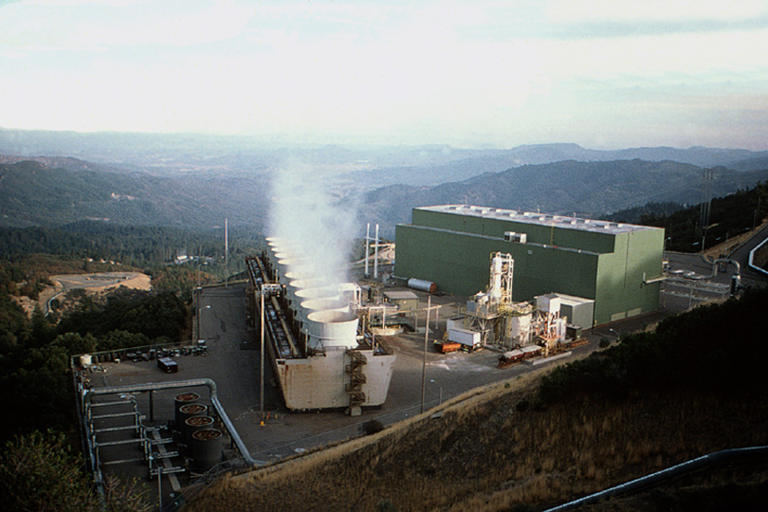
Thank You
The Geysers

Slide 44
Intentionally blank
Begin extra slides

Slide 45
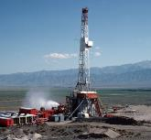
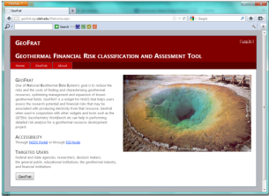
Approach to Data Management
Use WWW infrastructure, Open Geospatial Consortium (OGC) services, ISO standards
Simple interchange formats
Tiers of interoperability

Slide 46
NGDS_Resource
+
itemURI :anyURI
+subject
+
itemType :term
+
source :longText
1
+
relatedItem :link [0..*]
+documentation
+annotation
0..*
NGDS_DataResource
Metadata
Annotation
+
itemName :text
+
itemDescription :text [0..1]
1..*

Slide 47
NGDS_DataResource
+
itemName :text
+
itemDescription :text [0..1]
Tier 2,3
Tier 1
NGDSdataItem
+member
Dataset
UnstructuredResource
+
otherID :text [0..*]
1..*
Location
+position
Feature
Observation
1
+
featureOfInterestName :text
+
shape :geometry
1
+
label :shortText
+
featureOfInterestURI :anyURI
+
symbol :text
FeatureOfInterest
+
procedure :longText
+
observationDate :dateTime
GeologicFeature
Facility
SamplingFeature

Slide 48
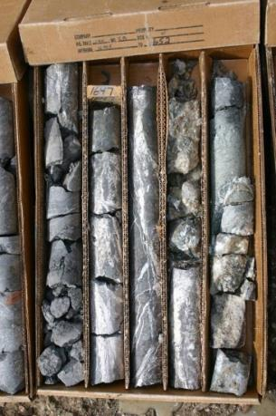
Data type recommendations
Well Logging
Geochemistry
Geophysics
Land Status and Ownership
Power Plant History
Well field Development Costs
Geothermal system resource models

Slide 49
Domain Steering Committee
Formed to determine data priorities
Represent user community
Toni Boyd: Geo-Heat Center Oregon Institute Technology: direct use data - national
Roland Horne: Stanford University-Stanford Reservoir Engineering Conference papers and research results
Joseph Moore: Energy & Geoscience Institute-legacy resource and research data (Chair)
Lisa Shevenell: University Nevada, Reno – legacy to recent resource and research data

Slide 50
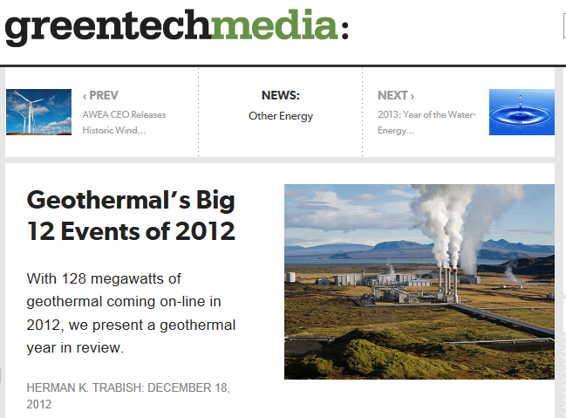
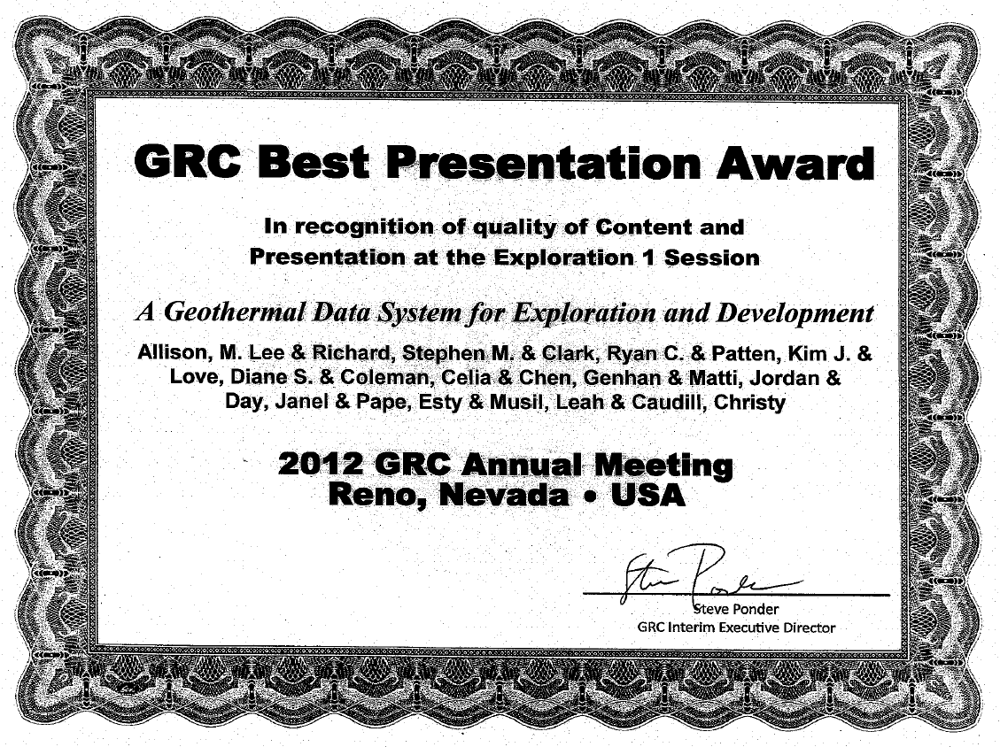
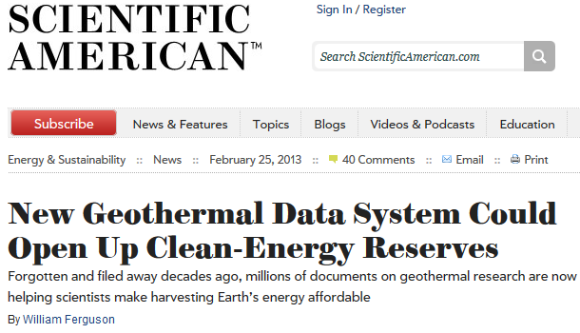
Industry Recognition
UGS discovery in the Black Rock Desert listed as #7
One of 34 Best Presentation Awards from over 180 presentations at 2012 GRC

Slide 51
Catalog system issues
How to manage metadata
Various streams for importing
Management system based on conceptual model
Metadata for machines– connect user to services inside of their user environment
Requires machine-actionable links
Document and file searching should be done with standard search engines

Slide 52
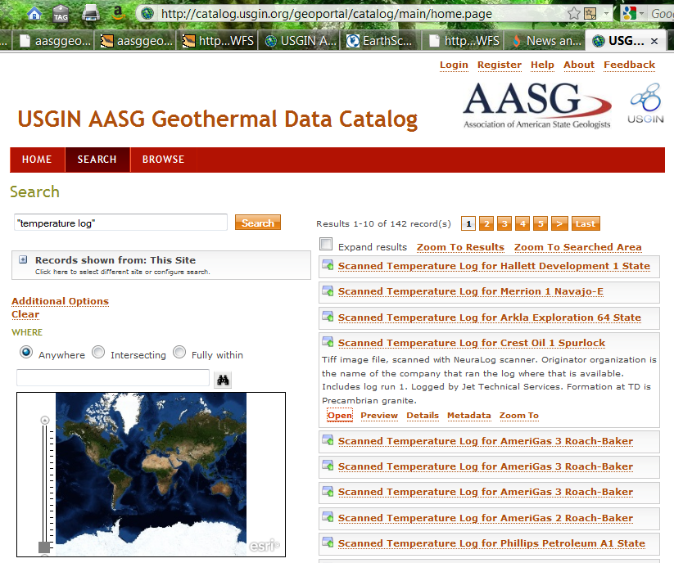
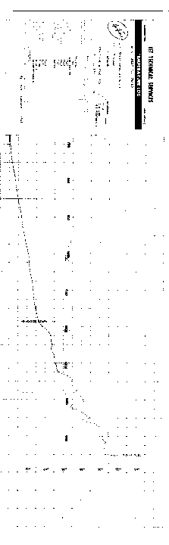

Slide 53
Domain Steering Committee Members
Toni Boyd: Geo-Heat Center Oregon Institute Technology: direct use data - national
Roland Horne: Stanford University-Stanford Reservoir Engineering Conference papers and research results
Joseph Moore: Energy & Geoscience Institute-legacy resource and research data (Chair)
Lisa Shevenell: University Nevada, Reno – legacy to recent resource and research data

Slide 54
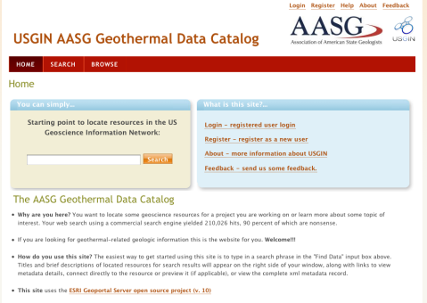
Search interfaces
Catalog -- for data discovery
Collection of consistent metadata describing network resources
Tested various catalog service implementations;
Current interface is ESRI Geoportal
(http://catalog.geothermaldata.org/geoportal)

Slide 55
AASG Geothermal data
Catalog file-based resources in repositories
Simple feature (flat file) schema
27 content models
More on the way –
http://geothermaldata.org
The goal is simple, really….

Slide 56

turn this….
Winona State U.

Slide 57
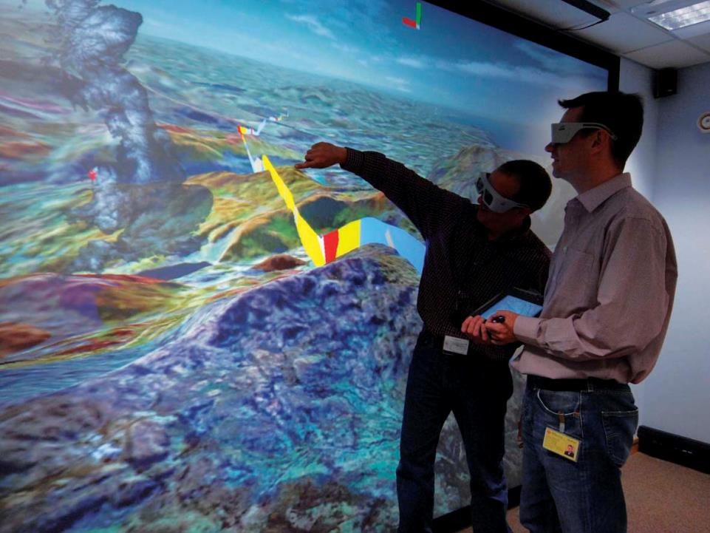
….into this
NERC 2008
Notes:
57
57

Slide 58
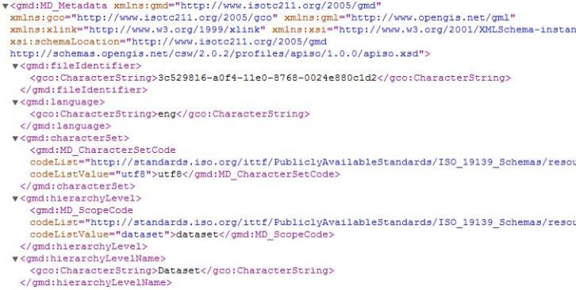
Metadata Interchange
Standard interchange format: USGIN Profile for ISO 19139 metadata (XML)
…

Slide 59
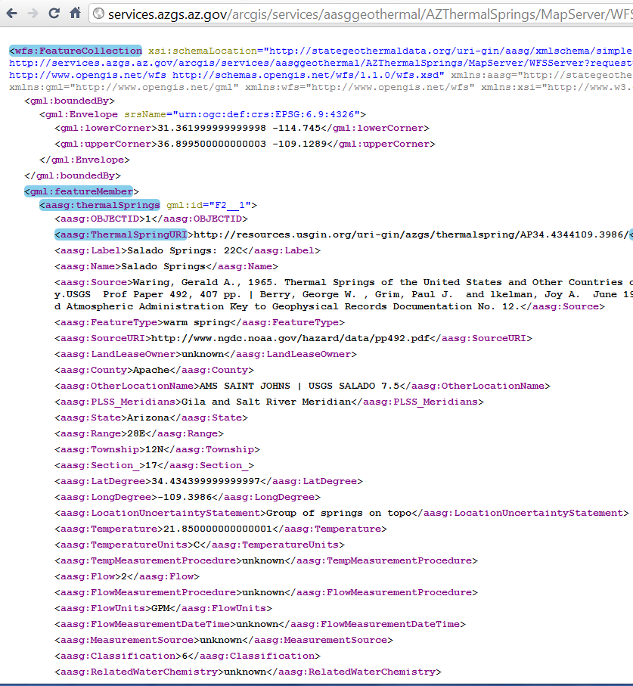
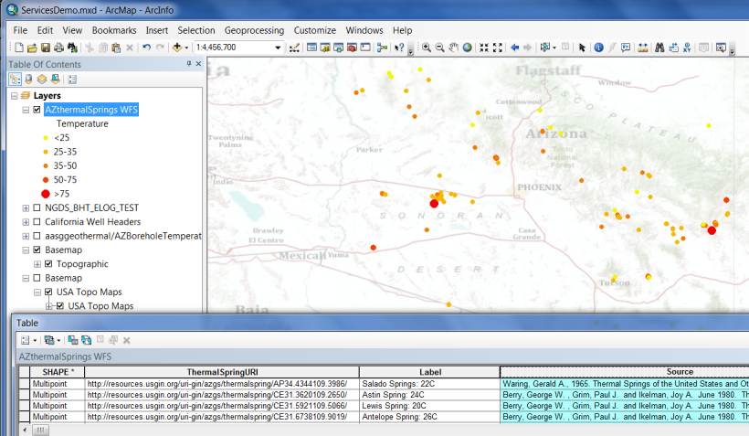
WFS example-Interchange format

Slide 60
Linked Data
Use identifiers that can be dereferenced on the WWW
Enable navigation between related resources
Leverage web architecture
GitHub\USGIN\Workshops\WesternRegionalWorkshopWMS_URIDemo.mxd

